Slide 1
Introduction to Graph Neural Networks
NVIDIA DLI

Slide 2
AGENDA
Graph 101
AI: Learning from Graph Data
GNN Fundamentals
Hands-On Lab

Slide 3

welcome
NOW
A GPU-accelerated server is being launched for interactive activities
Datasets, frameworks, and software are being loaded
H:MM:SS
LATER
Notes:
Go ahead and click the “Start” button below. You should now see a spinning wheel where the "Start" button used to be. Eventually (possibly 5-10 minutes), that spinning wheel will become a "Launch" button. While it’s loading, a GPU-accelerated server is being prepared for interactive activities. Datasets, frameworks, and software are being loaded to the instance for this course. Once it’s finished and you launched the task, you will see a Jupyter Lab containing instructions, activities, and links to guide you through the next sections. While we’re waiting – let’s go through some basics about what we’ll learn in the course. Most of the materials presented here will also be included in the Jupyter Lab.

Slide 4
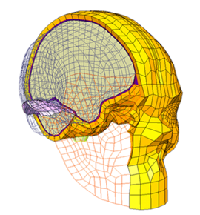
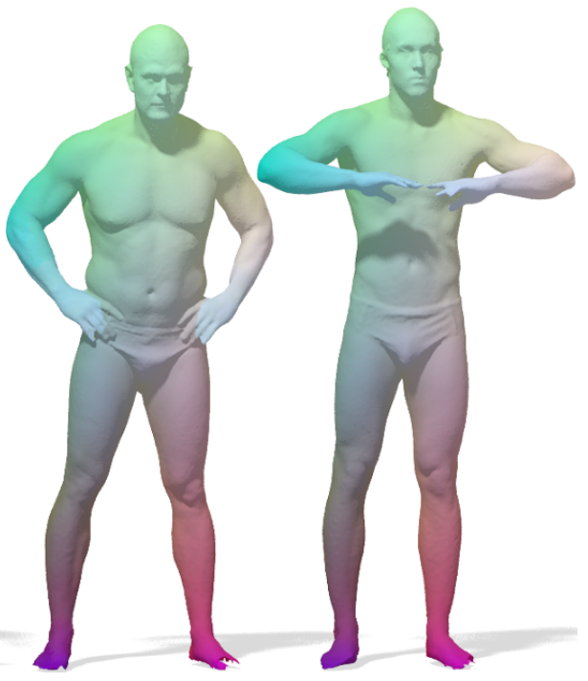
graph data
Used for Representing Unstructured Data
Volumetric Meshes
Surface Meshes

Slide 5
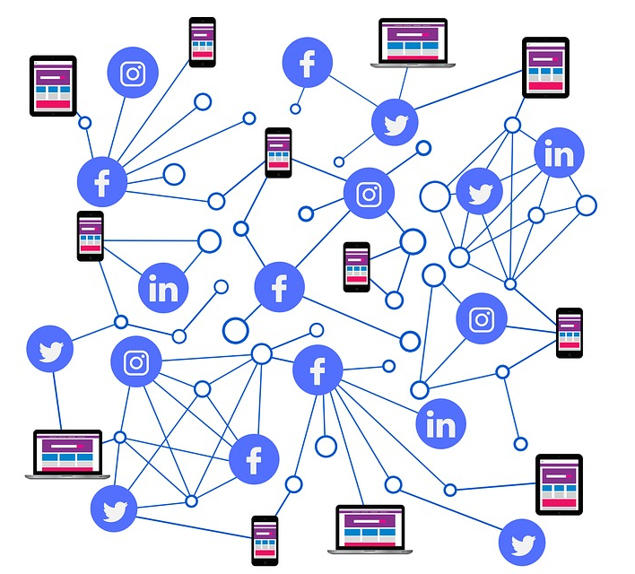
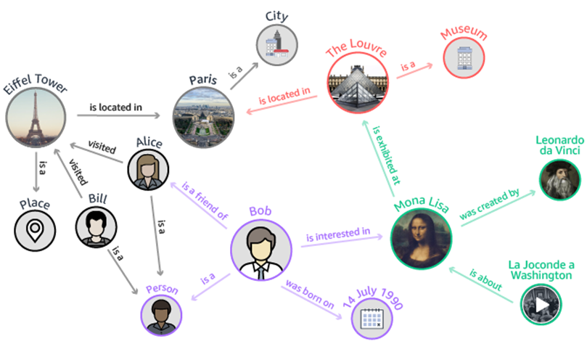
Common graph data use cases
Used to Gather Information About Relationships Between Objects
Knowledge Graphs
Social networks & Recommender Systems

Slide 6
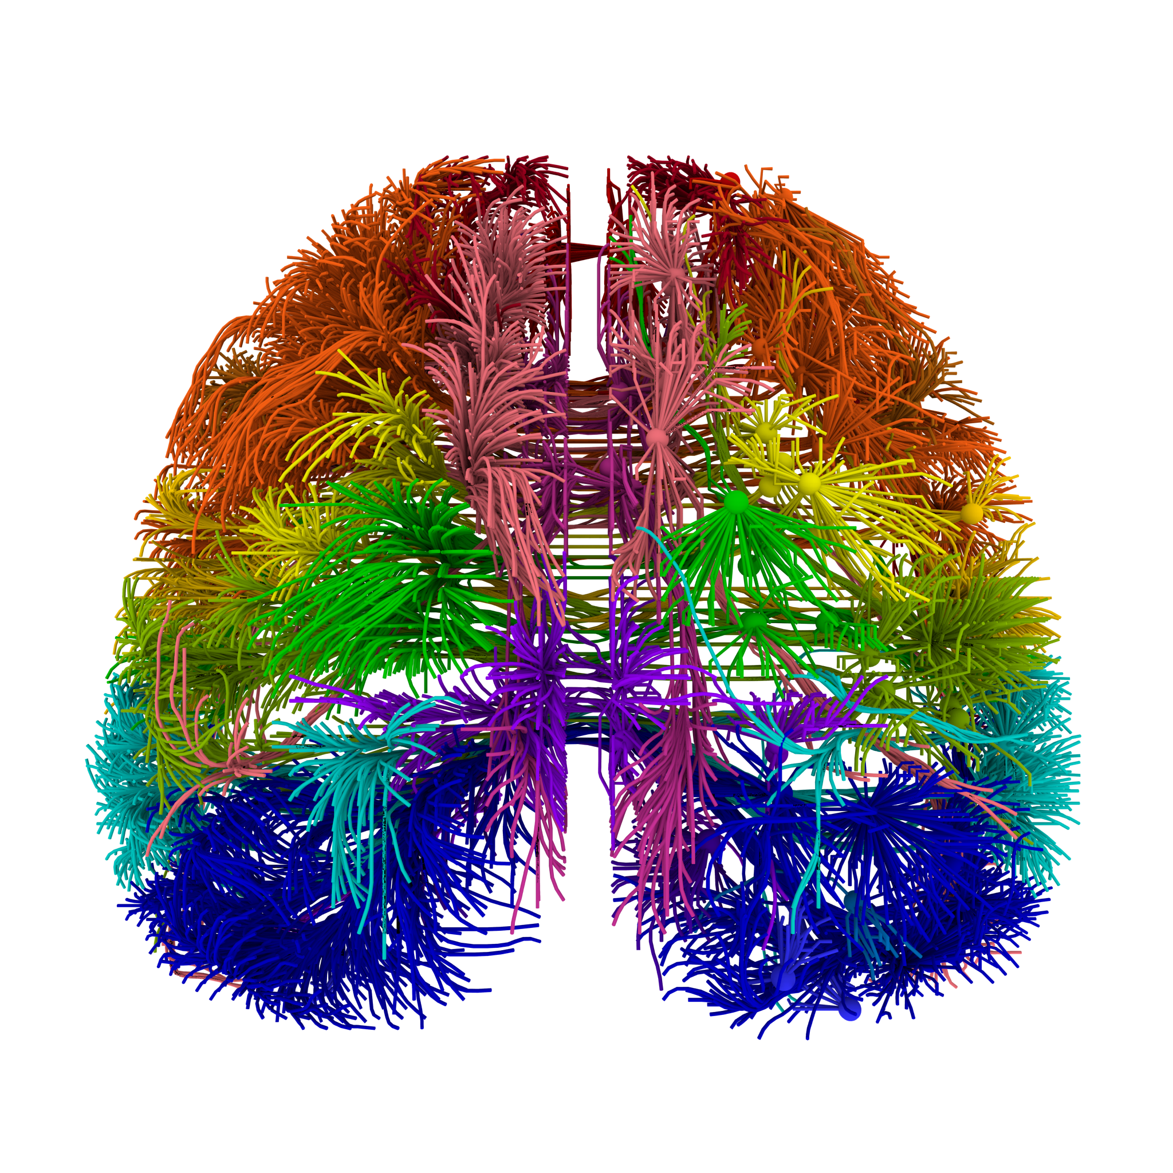
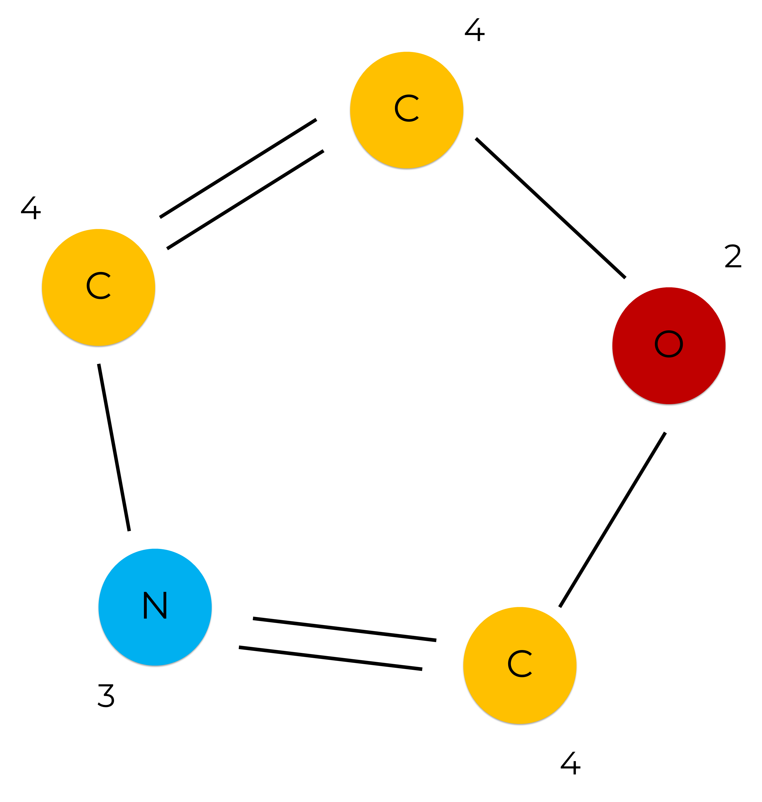
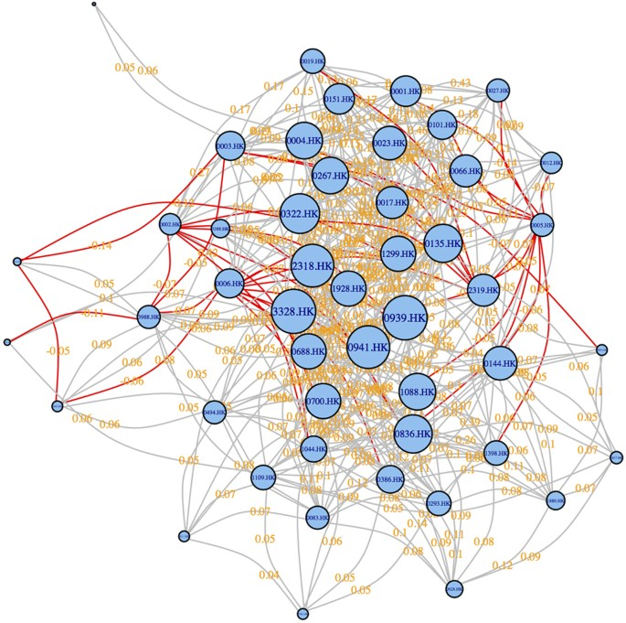
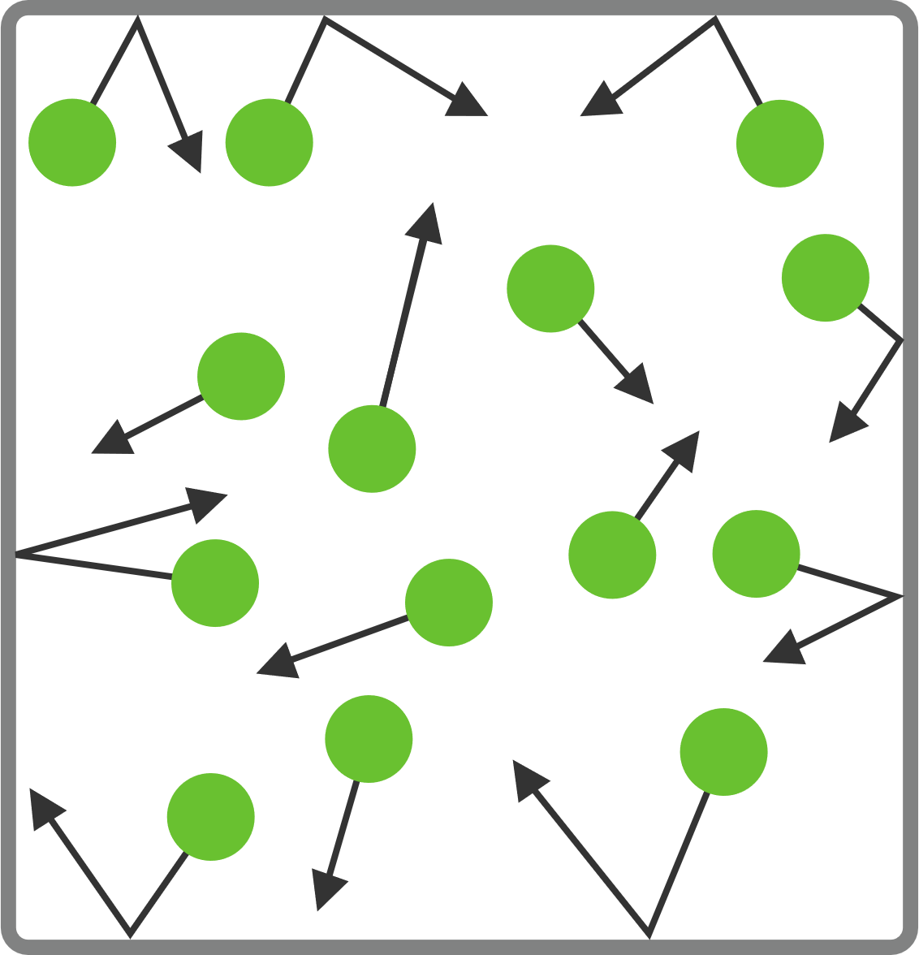
Common graph data use cases
Usage Extends Across Industries
Healthcare | Chemistry & Pharmacy | Financial Soundness Indicators | Physics
Connectomes Brian fMRI/DTI | Molecular Analysis Drug Discovery Drug Repurposing | Stock Market Prediction | Particle Systems Thermodynamics

Slide 7
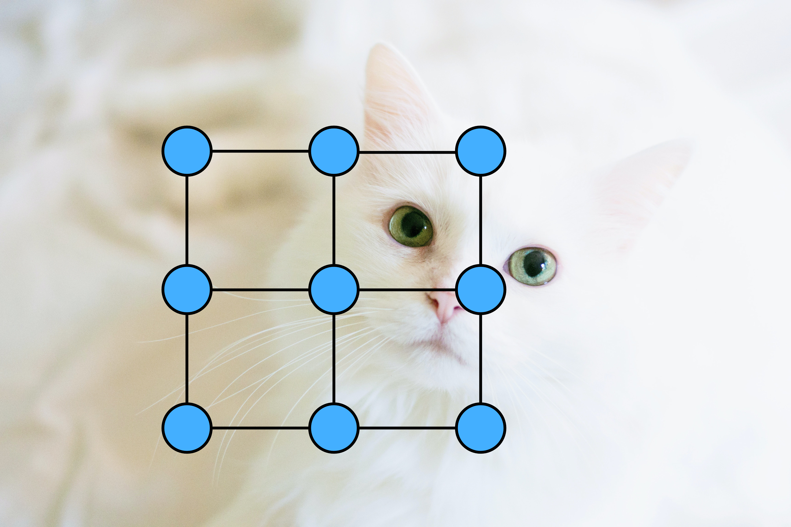
Images - Grid Graphs
Treating Images as Graphs Could Present Some Challenges

Slide 8
Graph 101

Slide 9
Anatomy of a graph
^{B}
Nodes (Vertices)
EDGES
^{A}
^{C}
GRAPH
^{D}
^{E}
^{F}

Slide 10
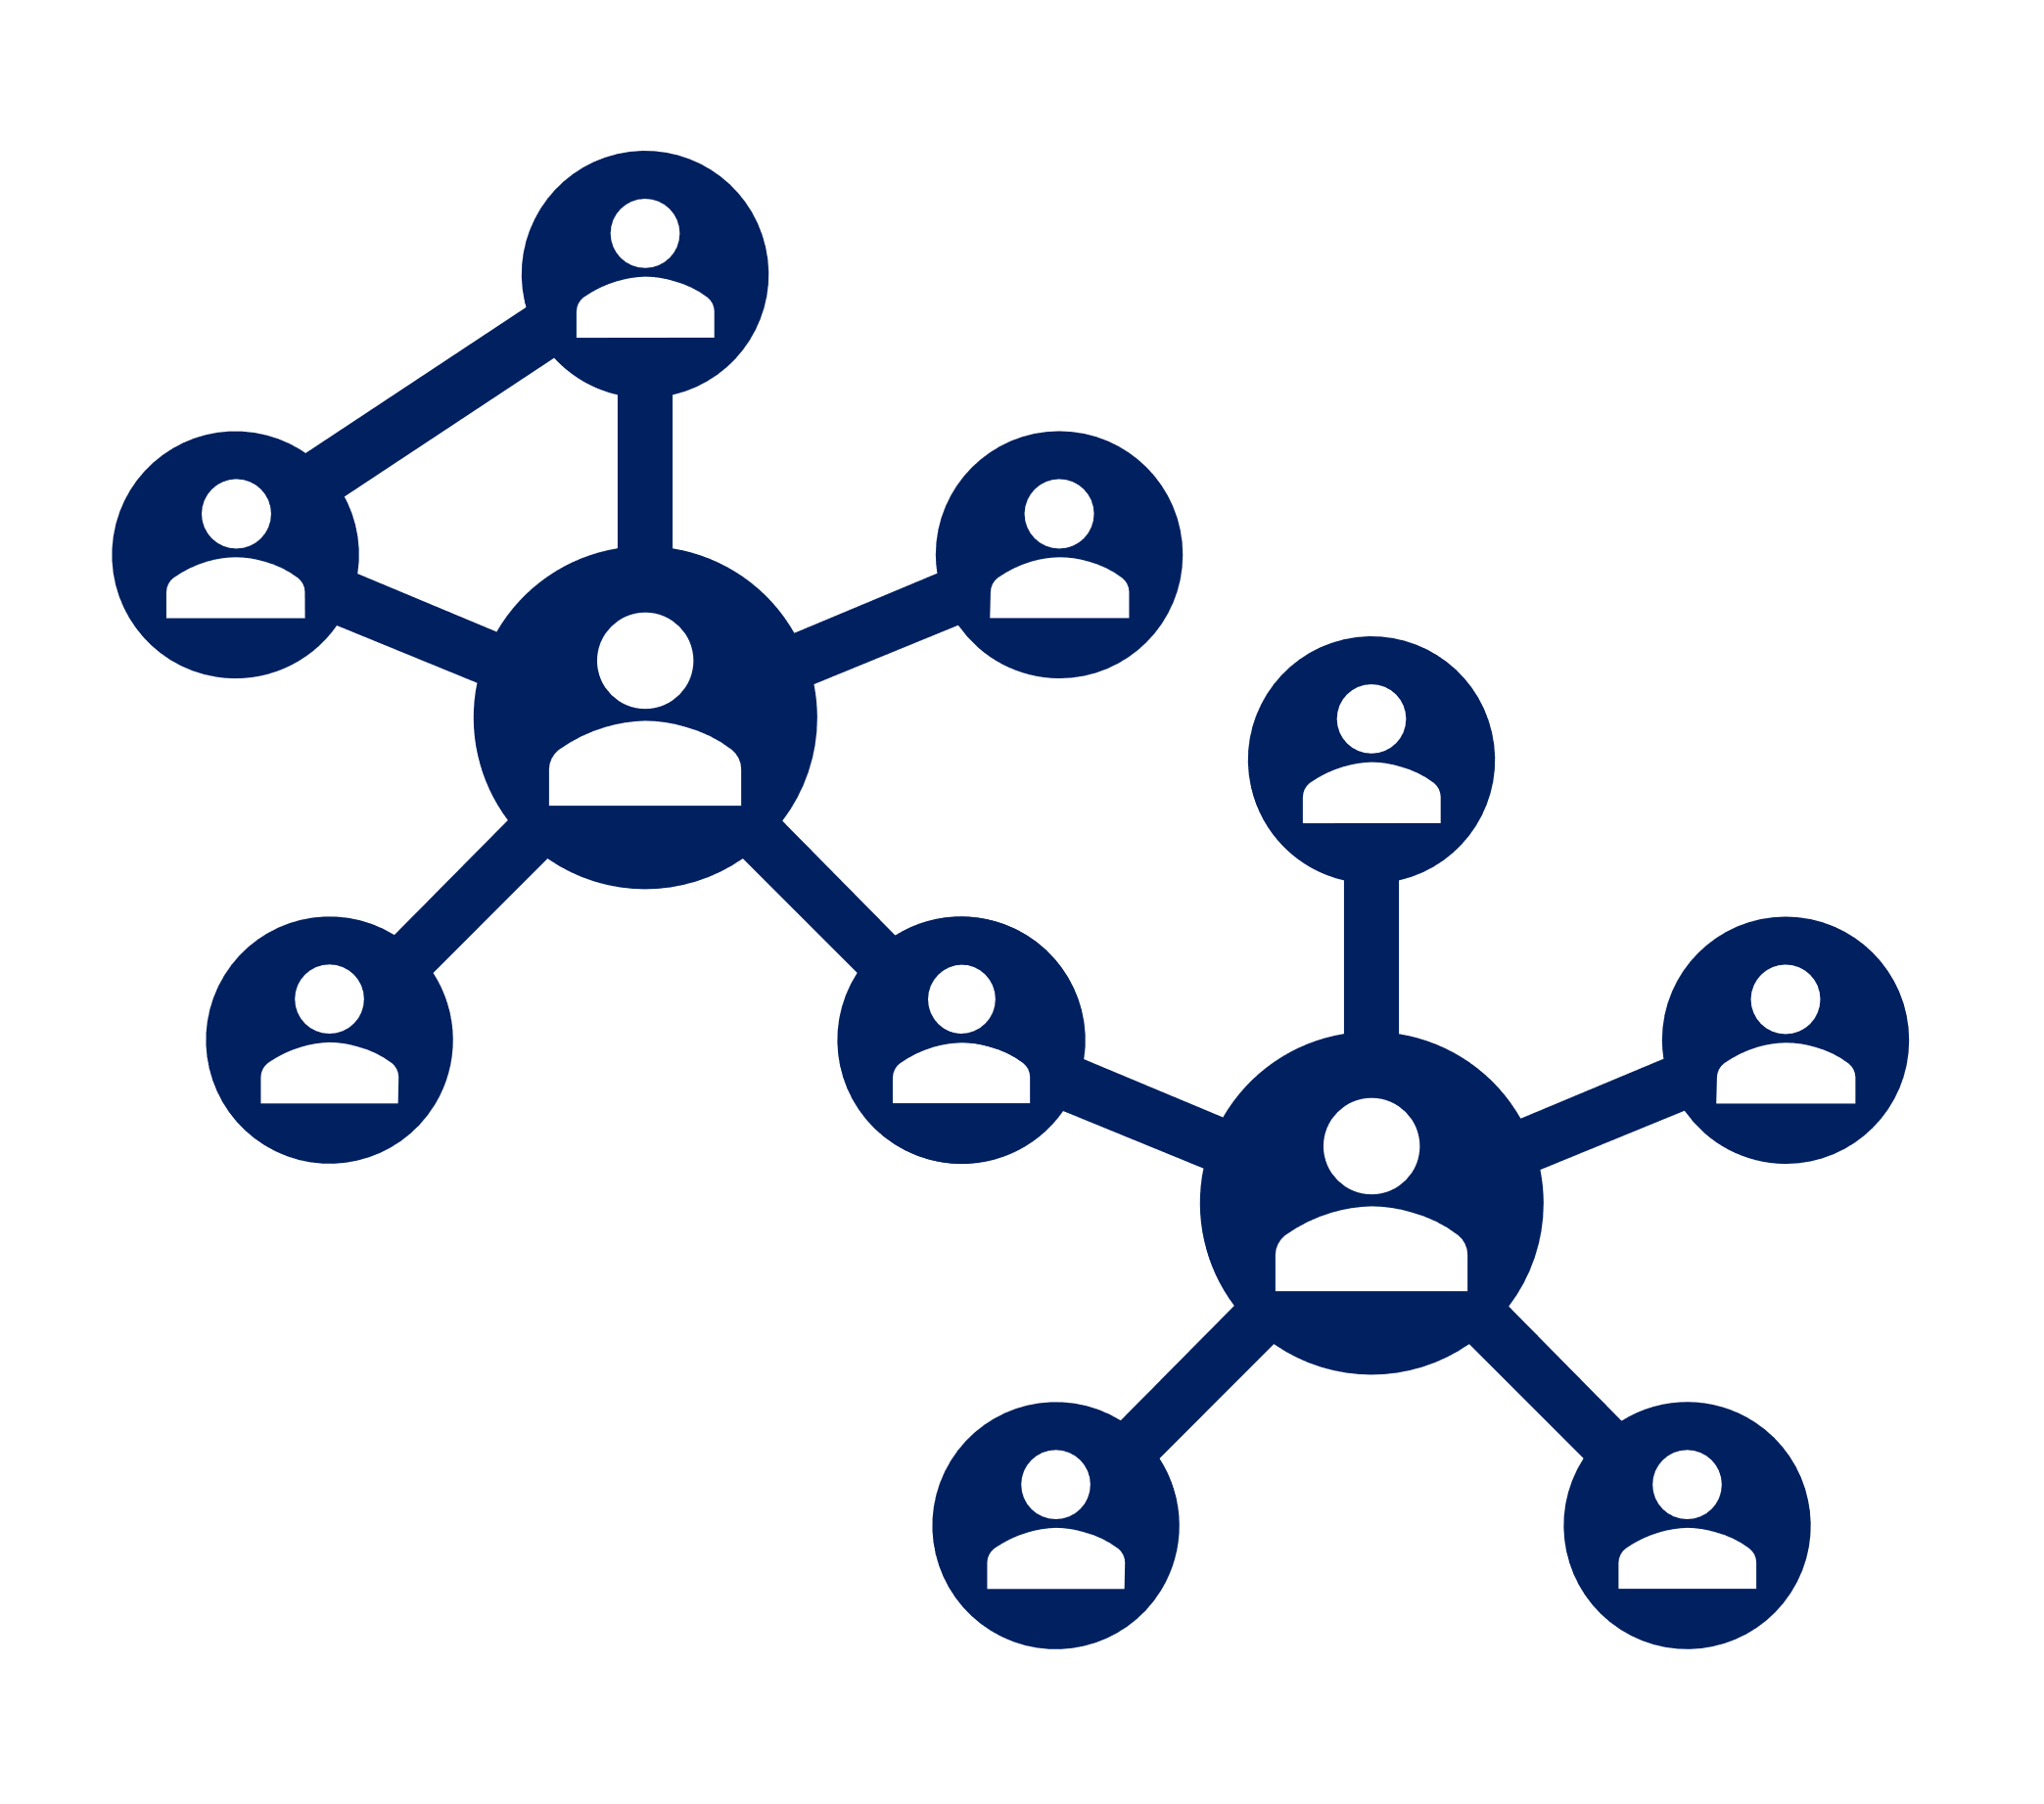
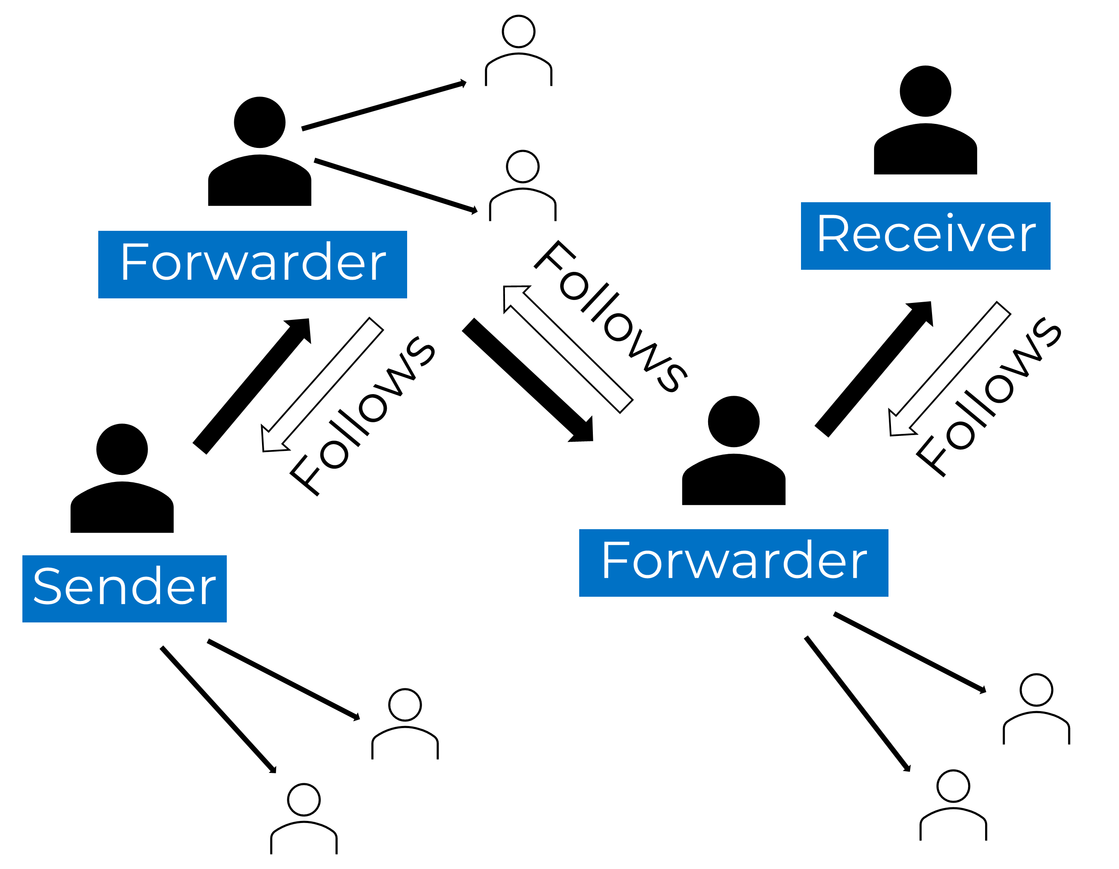
Edges
Directed, Undirected, Weighted, and Unweighted
FACEBOOK
TWITTER

Slide 11
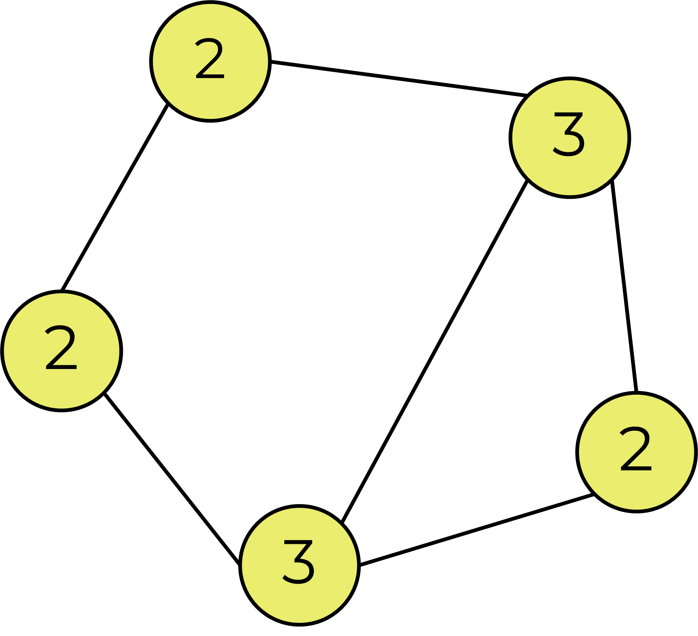
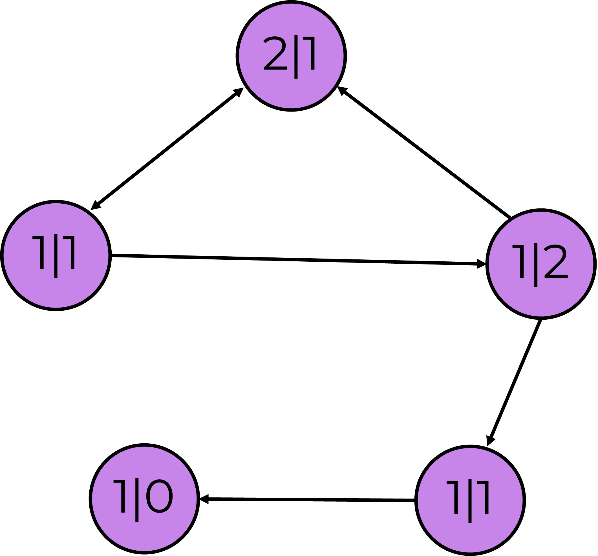
Edges
Degree, In-Degree, Out-Degree

Slide 12
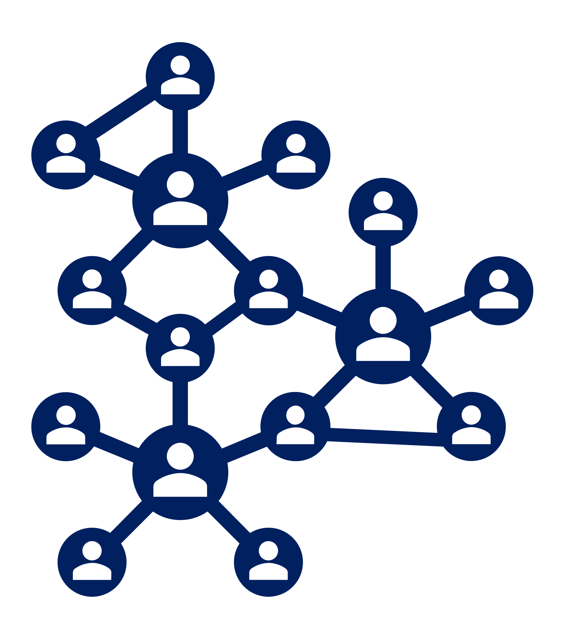
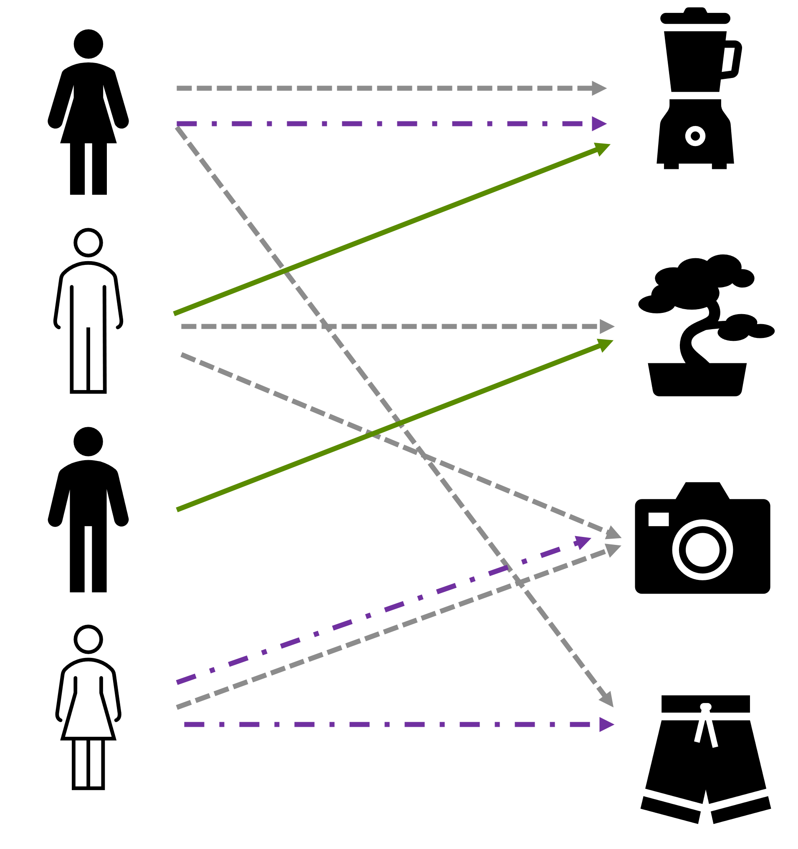
edges
Homogeneous vs. Heterogeneous
Social network
E-commerce

Slide 13
edges
Neighborhood
1-hop
A
2-hop

Slide 14
Representing Graphs
Adjacency Matrix Shows the Neighborhood of Each Node
 | A | B | C | D | E | F
A | 0 | 1 | 0 | 0 | 0 | 0
B | 1 | 0 | 1 | 0 | 0 | 0
C | 0 | 1 | 0 | 1 | 0 | 0
D | 0 | 0 | 1 | 0 | 1 | 1
E | 0 | 0 | 0 | 1 | 0 | 1
F | 0 | 0 | 0 | 1 | 1 | 0
^{B}
^{A}
^{C}
^{D}
^{E}
^{F}
Note: The adjacency matrix is symmetric for undirected graphs

Slide 15
Representing Graphs
Adjacency Matrix Can Also Be Used for a Weighted Graph
 | A | B | C | D | E | F
A | 0 | 0.5 | 0 | 0 | 0 | 0
B | 0.5 | 0 | 0.7 | 0 | 0 | 0
C | 0 | 0.7 | 0 | 0.1 | 0 | 0
D | 0 | 0 | 0.1 | 0 | 0.4 | 0.5
E | 0 | 0 | 0 | 0.4 | 0 | 0.9
F | 0 | 0 | 0 | 0.5 | 0.9 | 0
^{B}
0.5
0.7
^{A}
^{C}
0.1
^{D}
0.4
0.5
^{E}
0.9
^{F}
Note: The adjacency matrix is symmetric for undirected graphs

Slide 16
Representing Graphs
Degree Matrix Counts Number of Connections to Each Node
 | A | B | C | D | E | F
A | 2 | 0 | 0 | 0 | 0 | 0
B | 0 | 2 | 0 | 0 | 0 | 0
C | 0 | 0 | 2 | 0 | 0 | 0
D | 0 | 0 | 0 | 3 | 0 | 0
E | 0 | 0 | 0 | 0 | 2 | 0
F | 0 | 0 | 0 | 0 | 0 | 2
^{B}
^{A}
^{C}
^{D}
^{E}
^{F}
Note: Illustration assumes unweighted and undirected graph

Slide 17
Representing Graphs
Laplacian Matrix Shows the Smoothness of the Graph
 | A | B | C | D | E | F
A | 2 | -1 | 0 | 0 | 0 | 0
B | -1 | 2 | -1 | 0 | 0 | 0
C | 0 | -1 | 2 | -1 | 0 | 0
D | 0 | 0 | -1 | 3 | -1 | -1
E | 0 | 0 | 0 | -1 | 2 | -1
F | 0 | 0 | 0 | -1 | -1 | 2
^{B}
^{A}
^{C}
Represented as L, where
L = { D – A }
D = Degree Matrix and
A = Adjacency Matrix
^{D}
^{E}
^{F}

Slide 18
Representing Graphs
Graphs Can Also Be Represented by an Adjacency List
Adjacency | Edges | Nodes
[[1, 2], [2, 3], [3, 4], [4, 5], [4, 6], [5, 6]] | [0.5, 0.7, 0.1, 0.4, 0.5, 0.9] | [0.7, 0.4, 0.9, 0.3, 0.9, 0.5]
^{0.4}
0.5
0.7
^{0.7}
^{0.9}
0.1
^{0.3}
0.4
0.5
^{0.9}
0.9
^{0.5}
Note: Representing graph structure as adjacency lists can be more efficient

Slide 19
AI: Learning from graph data

Slide 20
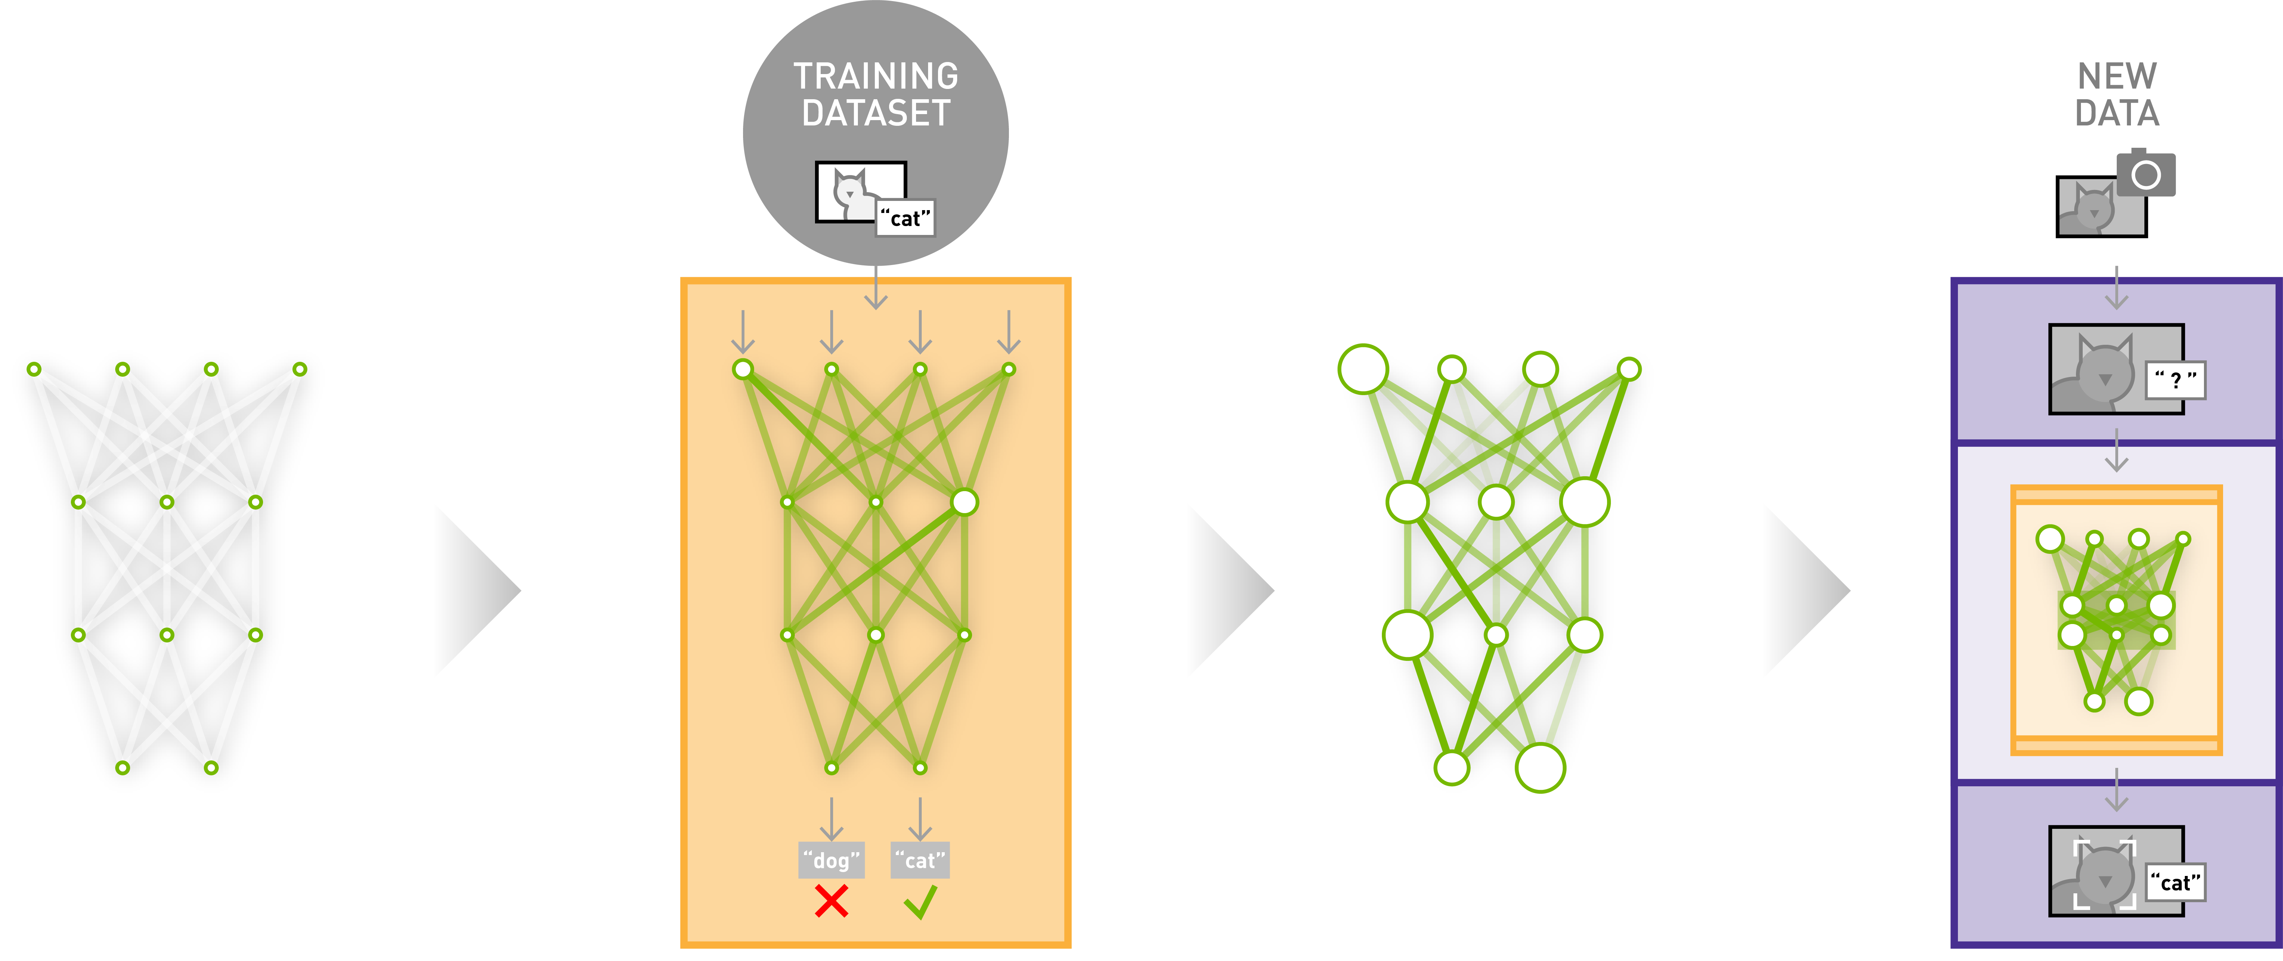
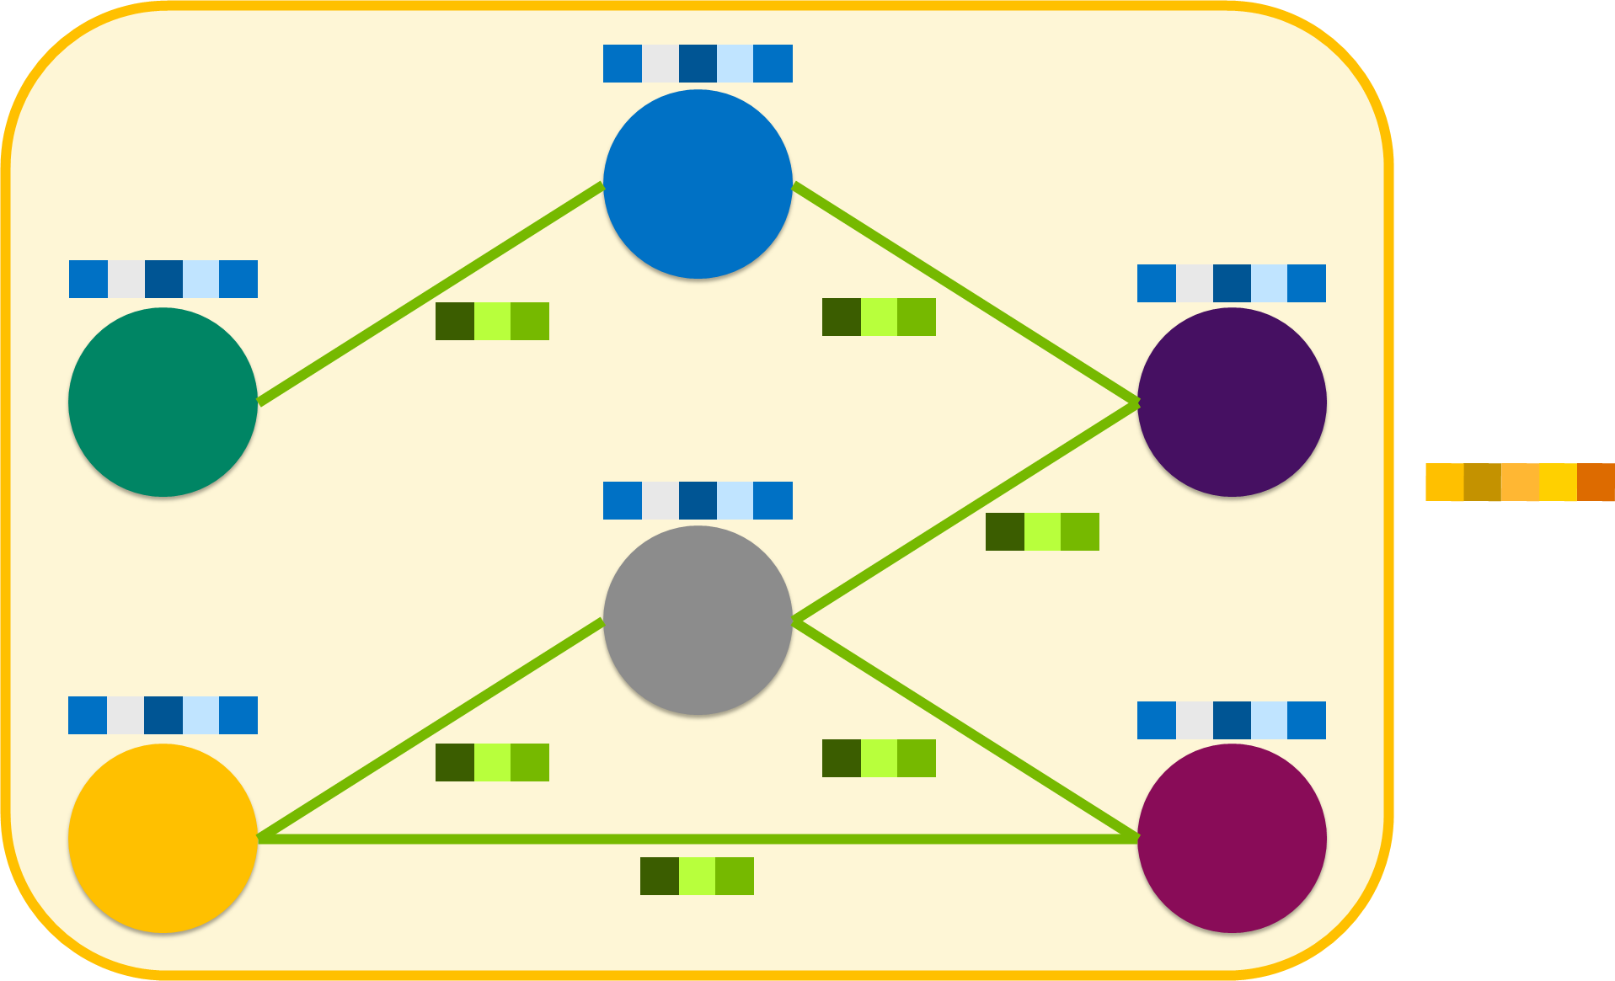
Graph Neural Networks
Learn the Function(s) to Predict Graph-Level, Node-Level, or Edge-Level Features
Global Graph Features
Node Features
Edge Features
Learnable Function (Graph Neural Network)

Slide 21
Graph Neural Networks
Neural Networks That Operate on Graphs
Graph data is a challenge as standard deep learning methods focus primarily on structured data, such as fixed-size pixel grids (images) and sequences (text).
Graph neural networks, or GNN, refers to a variety of different approaches for applying deep learning on graphs that:
Take full advantage of the graph structure
Considers scalability and efficiency based on the size of the graph and its features
Graph neural networks that use various techniques, which typically involve learning the latent / embedding space(s) to represent node features that are mindful of a node’s direct neighborhood in the graph, have become the most popular approaches:
Message Passing Neural Networks (MPNN)
Graph Convolution Networks (GCN)
Graph Attention networks (GAT)

Slide 22
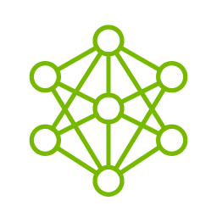





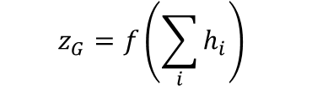





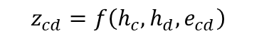



GNN Tasks
Learn the Function(s) to Predict Graph-Level, Node-Level, or Edge-Level Features
Input Graph
Latent Features
NOTE: Illustration assumes unweighted and undirected graph
Global Graph Features
$$x_{B}$$
$$h_{B}$$
$$z_{G}=f\left(\sum_{i}{h_{i}}\right)$$
$$x_{A}$$
$$x_{C}$$
$$h_{A}$$
$$h_{C}$$
Node Features
$$x_{D}$$
GNN
$$h_{D}$$
$$z_{i}=f\left(h_{i}\right)$$
Edge Features
$$x_{E}$$
$$x_{F}$$
$$h_{E}$$
$$h_{F}$$
$$z_{cd}=f\left(h_{c},h_{d},e_{cd}\right)$$
Apply special neural network layer(s) that can exploit local interactions and update features to a latent space to represent nodes with features that are mindful of a node’s neighbors.
Apply neural network layer(s) based on the specific task

Slide 23
Graph-level Task
Use (Latent) Node Features and Edge Features to Predict a Global Graph Property
NOTE: Illustration assumes unweighted and undirected graph
Input Graph
Latent Features
Global Graph Features
$$x_{B}$$
$$h_{B}$$
$$z_{G}=f\left(\sum_{i}{h_{i}}\right)$$
$$x_{A}$$
$$x_{C}$$
$$h_{A}$$
$$h_{C}$$
Node Features
$$x_{D}$$
GNN
$$h_{D}$$
Edge Features
$$x_{E}$$
$$x_{F}$$
$$h_{E}$$
$$h_{F}$$

Slide 24
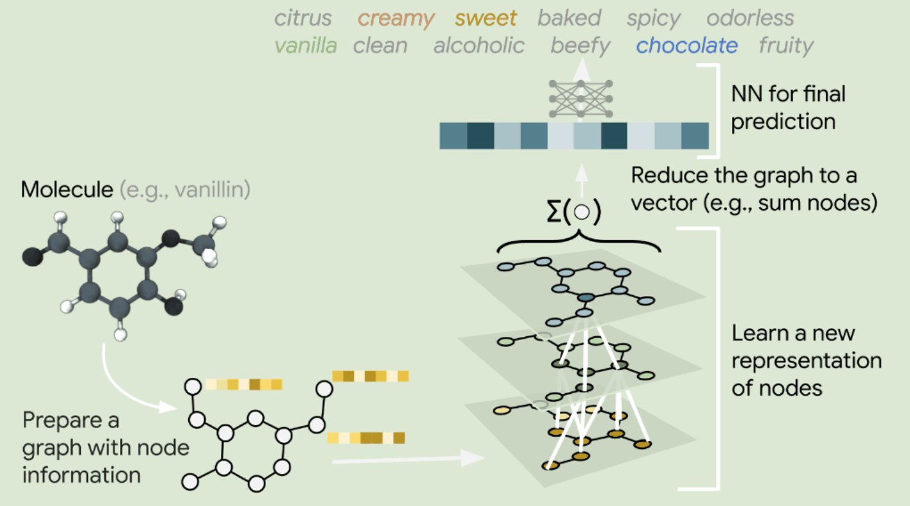
Example Graph-level Task
Google Experimented with Using GNN to Perform Classification at the Graph Level
Objective:
To predict the smell of molecules by framing molecules as graphs
Image credit: ai.googleblog.com

Slide 25
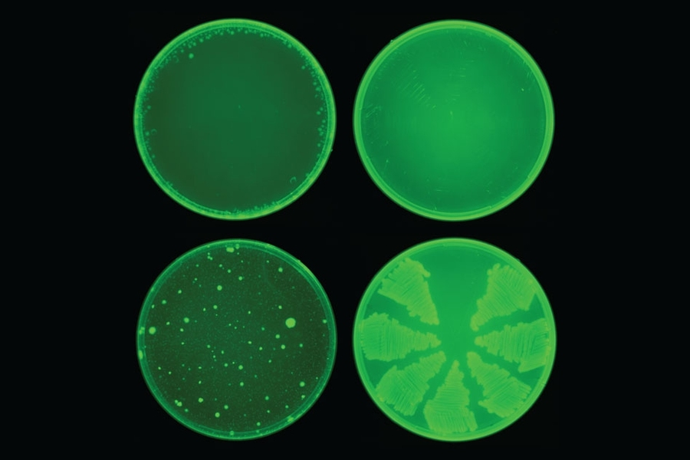
Example Graph-LEVEL Tasks
MIT Successfully Discovered Halicin’s Effectiveness Against Multi-Resistant Bacteria
Objective:
To predict molecule toxicity rating
Image credit: news.mit.edu

Slide 26
Node prediction
Take (Latent) Node Features and Edge Features to Predict a Node Property
NOTE: Illustration assumes unweighted and undirected graph
Input Graph
Latent Features
Global Graph Features
$$x_{B}$$
$$h_{B}$$
$$x_{A}$$
$$x_{C}$$
$$h_{A}$$
$$h_{C}$$
Node Features
$$x_{D}$$
GNN
$$h_{D}$$
$$z_{i}=f\left(h_{i}\right)$$
Edge Features
$$x_{E}$$
$$x_{F}$$
$$h_{E}$$
$$h_{F}$$

Slide 27
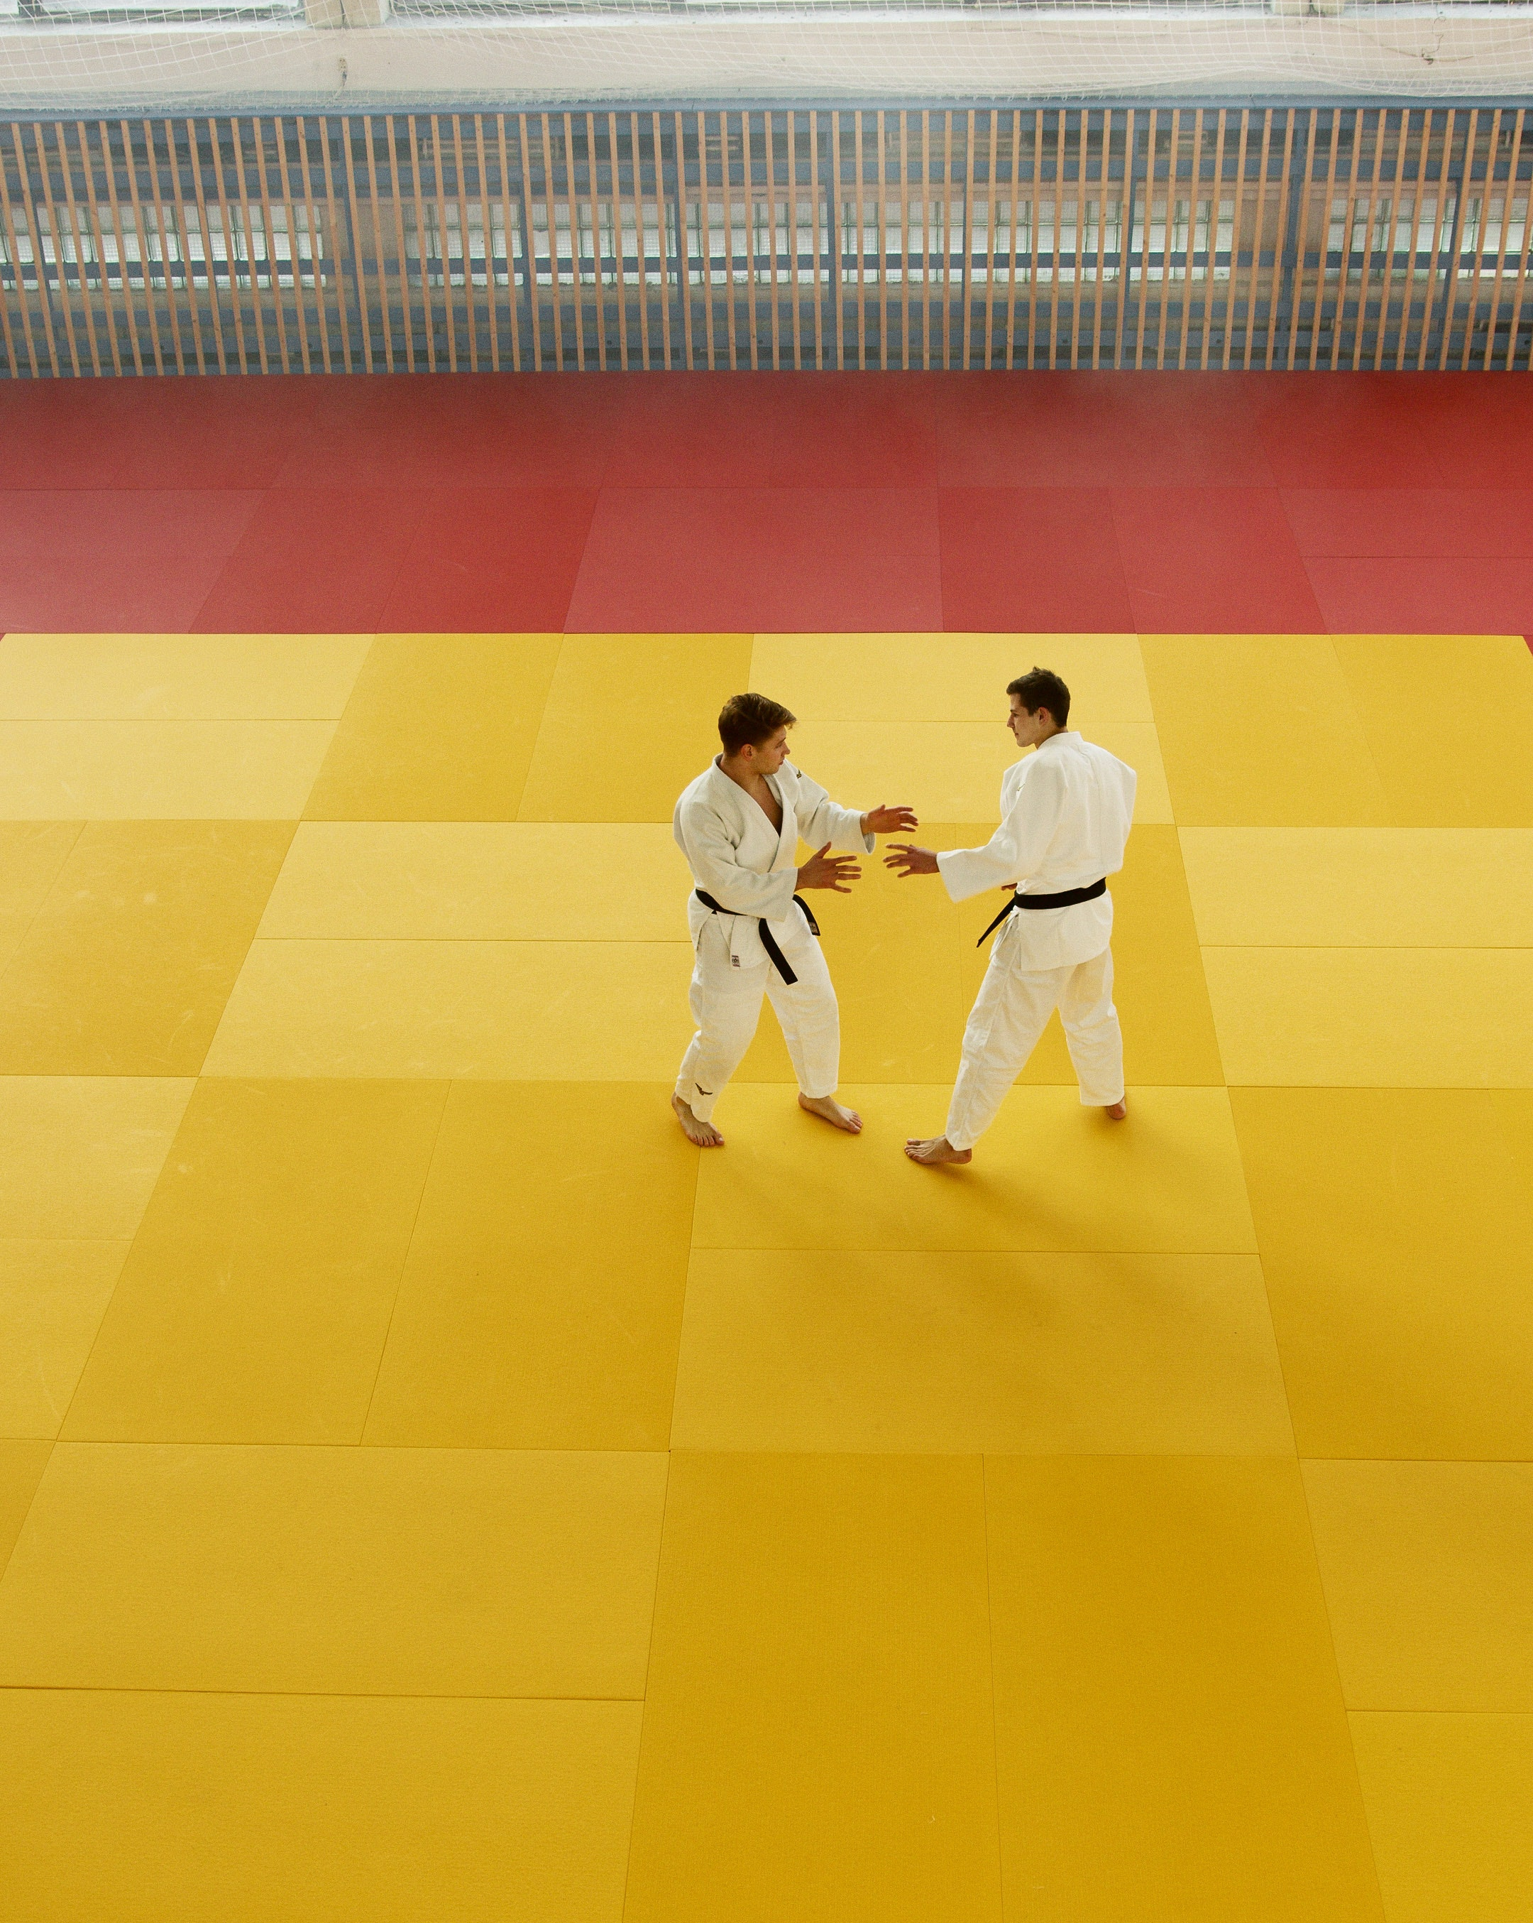
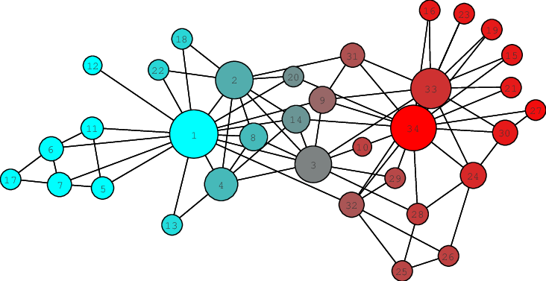
Node-Level Tasks
Classification
Zachary Karate Club – the ‘Hello World’ of GNNs

Slide 28
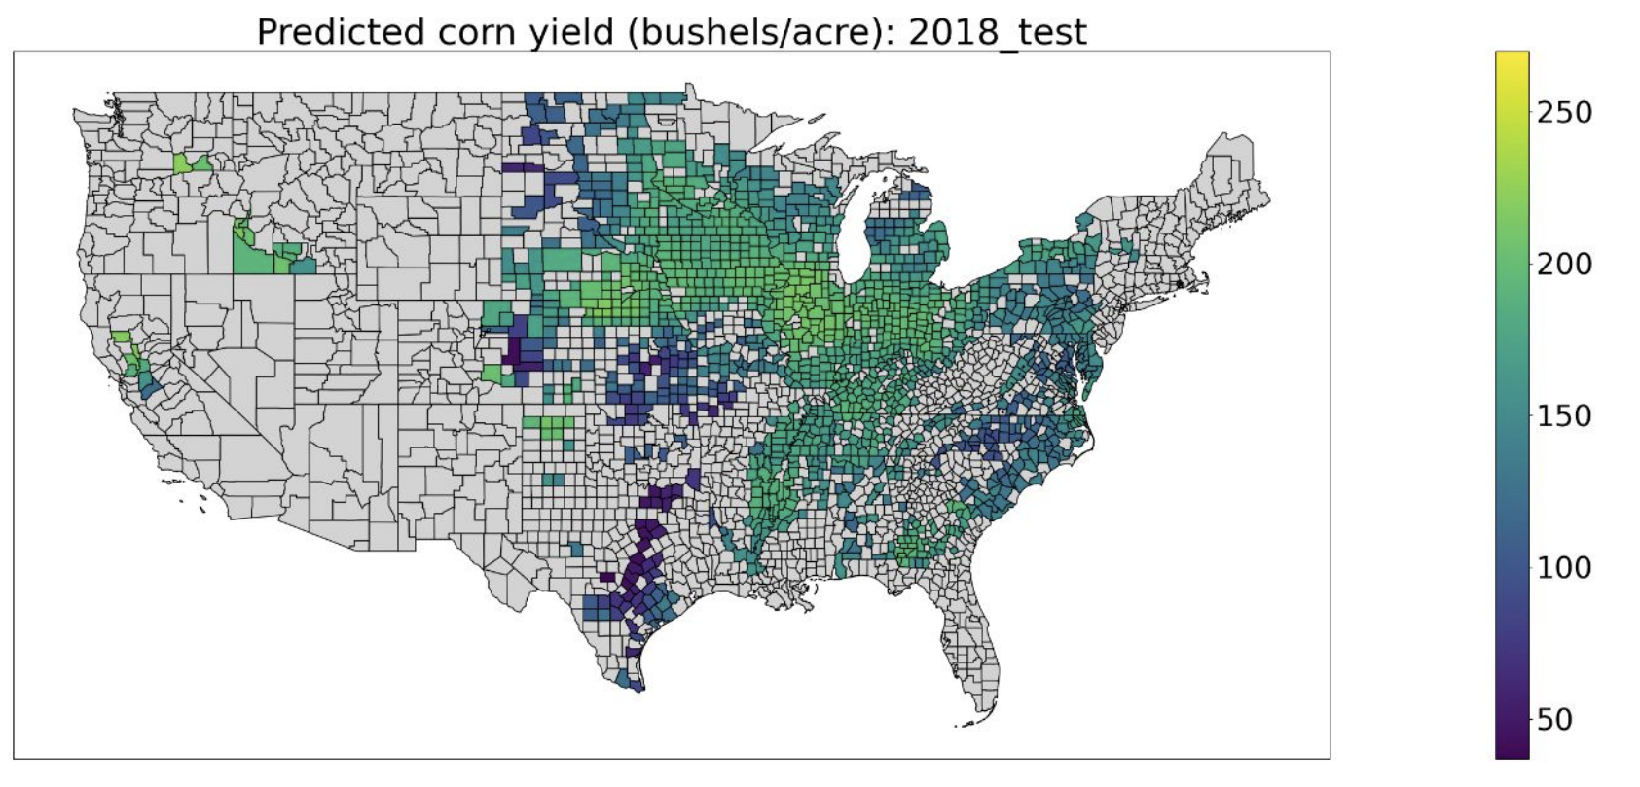
Node-Level Tasks
Regression
Predict values in each node: continuous outcome variables
Research at Cornell: utilizing geospatial and temporal information for crop yield prediction
Image credit: proceeding NeurIPS 2021

Slide 29
Link/edge prediction
Predict the Weight and Class of Graph Edges
Input Graph
Latent Features
NOTE: Illustration assumes unweighted and undirected graph
Global Graph Features
^{B}
$$h_{B}$$
^{A}
^{C}
$$h_{A}$$
$$h_{C}$$
Node Features
^{D}
GNN
$$h_{D}$$
Edge Features
^{E}
^{F}
$$h_{E}$$
$$h_{F}$$
$$z_{cd}=f\left(h_{c},h_{d},e_{cd}\right)$$

Slide 30
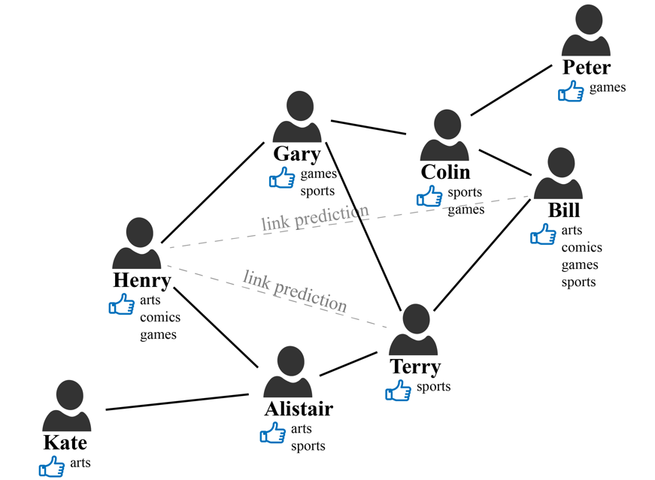
Edge-Level Tasks
Link prediction
E-commerce / digital media: recommend product / content A to a customer / user B
Social network: recommend friends
Image credit: aws.amazon.com/blogs

Slide 31
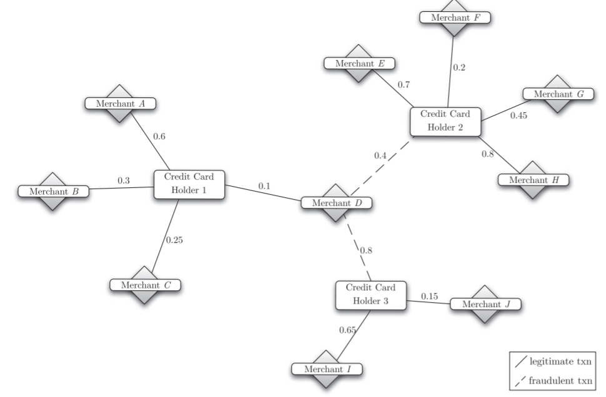
Edge-Level Tasks
Classification
Predict fradulent transactions:
APATE: A novel approach for automated credit card transaction fraud detection using network-based extensions
Image credit: Decision Support Systems 2015

Slide 32
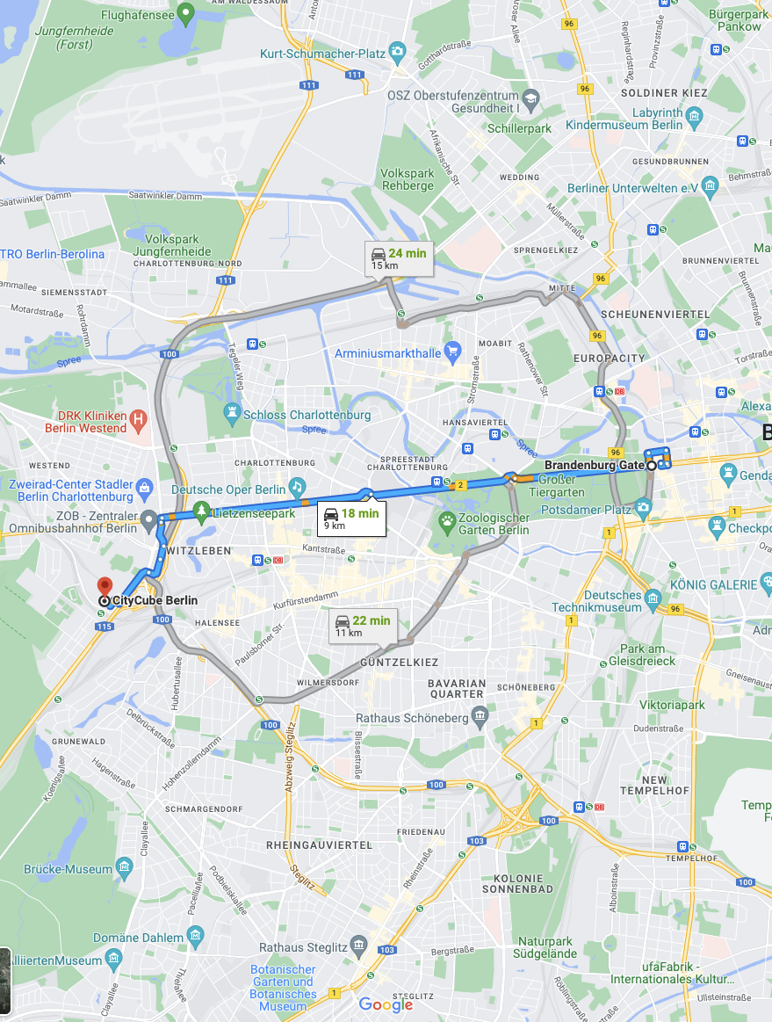
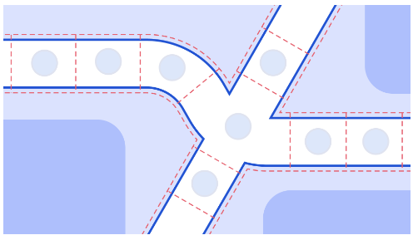
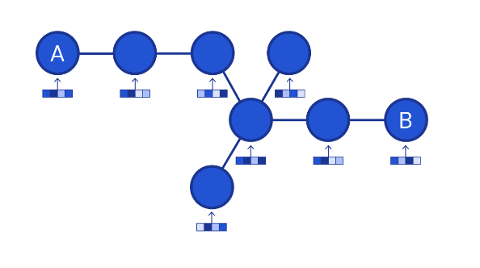
Edge-Level Tasks
Regression
Google Maps: estimate time to travel from A to B
Image credit: DeepMind

Slide 33
GNN Fundamentals

Slide 34
Message Passing and GRAPH Convolution
Principal Ideas Behind Most GNN Architectures
Message passing is when each node in a graph sends information about itself to its neighbors and receives messages back from them to update its status and understand its environment
Enables nodes to aggregate neighboring features and update its own
Convolution is popularly used to analyze images, which is generalized to be applicable on graphs
Graph convolution combines information from neighborhoods and encodes updated node features to embeddings
Various aggregation methods to handle different use cases
The aggregation method should be permutation invariant, i.e. independent from the ordering of the nodes
Can be thought of as a simple message passing algorithm that involves a linear combination of neighborhood features where weights used for the aggregation depend only on the structure of the graph

Slide 35
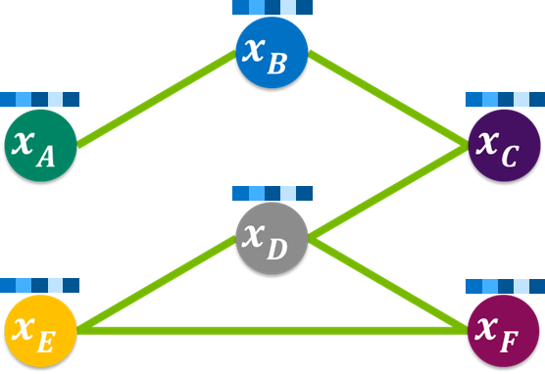
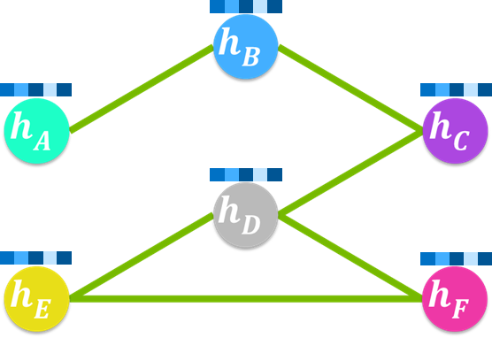
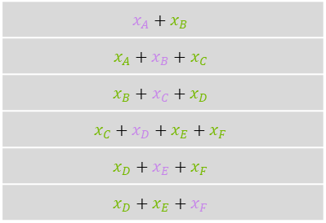
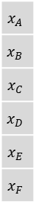
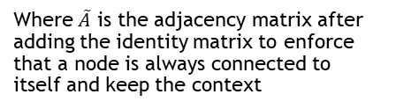
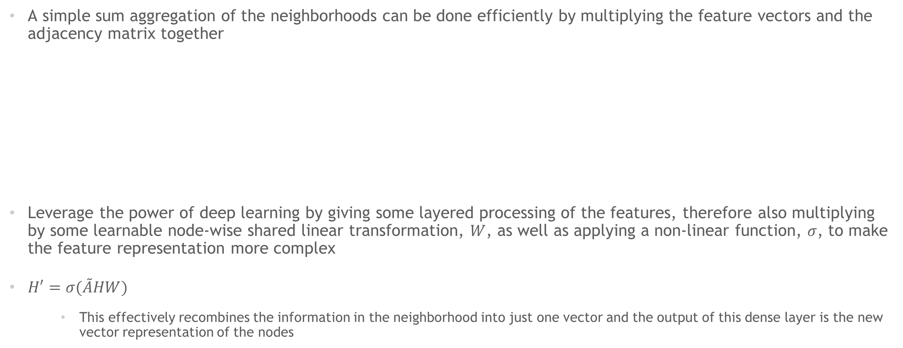
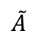
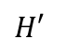
GNN: Sum-pooling
Sum-Pooling Update Rule
A simple sum aggregation of the neighborhoods can be done efficiently by multiplying the feature vectors and the adjacency matrix together
Leverage the power of deep learning by giving some layered processing of the features, therefore also multiplying by some learnable node-wise shared linear transformation, $W$, as well as applying a non-linear function, $σ$, to make the feature representation more complex
$H′=σ(\tilde{A}HW)$
This effectively recombines the information in the neighborhood into just one vector and the output of this dense layer is the new vector representation of the nodes
 | A | B | C | D | E | F
A | 1 | 1 | 0 | 0 | 0 | 0
B | 1 | 1 | 1 | 0 | 0 | 0
C | 0 | 1 | 1 | 1 | 0 | 0
D | 0 | 0 | 1 | 1 | 1 | 1
E | 0 | 0 | 0 | 1 | 1 | 1
F | 0 | 0 | 0 | 1 | 1 | 1
$$x_{A}$$
$$x_{B}$$
$$x_{C}$$
$$x_{D}$$
$$x_{E}$$
$$x_{F}$$
$$x_{A}+x_{B}$$
$$x_{A}+x_{B}+x_{C}$$
$$x_{B}+x_{C}+x_{D}$$
$$x_{C}+x_{D}+x_{E}+x_{F}$$
$$x_{D}+x_{E}+x_{F}$$
$$x_{D}+x_{E}+x_{F}$$
x
=
$$\tilde{A}$$
H
$$H′$$
Note: Assuming graph is unweighted and undirected, i.e. adjacency matrix is binary and symmetrical
Where $\tilde{A}$ is the adjacency matrix after adding the identity matrix to enforce that a node is always connected to itself and keep the context
The adjacency matrix masks out all the values except for the one(s) that the node has connection with. This operations sum the values of the nodes connections and ignored all the others

Slide 36
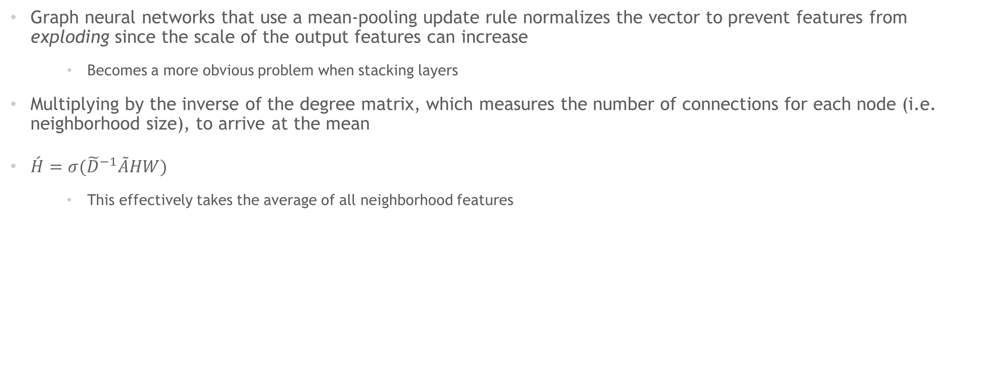
GNN: Mean-pooling
Mean-Pooling Update Rule
Graph neural networks that use a mean-pooling update rule normalizes the vector to prevent features from exploding since the scale of the output features can increase
Becomes a more obvious problem when stacking layers
Multiplying by the inverse of the degree matrix, which measures the number of connections for each node (i.e. neighborhood size), to arrive at the mean
$\acute{H}=σ({\tilde{D}}^{−1}\tilde{A}HW)$
This effectively takes the average of all neighborhood features

Slide 37
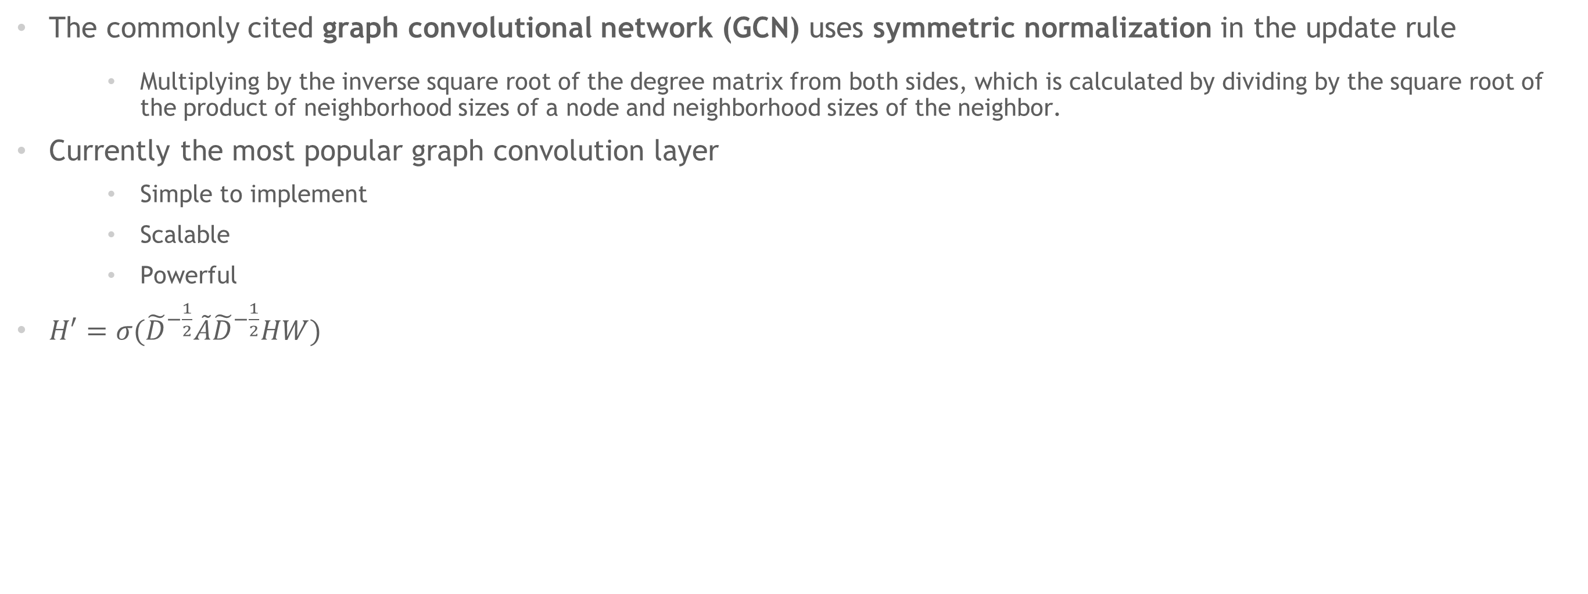
GNN: Symmetric Normalization
Popular GCN Proposed by Kipf and Welling
The commonly cited graph convolutional network (GCN) uses symmetric normalization in the update rule
Multiplying by the inverse square root of the degree matrix from both sides, which is calculated by dividing by the square root of the product of neighborhood sizes of a node and neighborhood sizes of the neighbor.
Currently the most popular graph convolution layer
Simple to implement
Scalable
Powerful
$H′=σ({\tilde{D}}^{−\frac{1}{2}}\tilde{A}{\tilde{D}}^{−\frac{1}{2}}HW)$

Slide 38
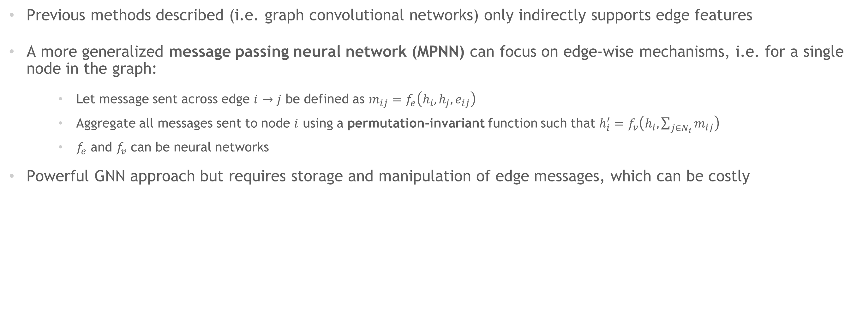
Message Passing Neural Networks
Nodes Can Send and Receive Messages Along Graph Edges
Previous methods described (i.e. graph convolutional networks) only indirectly supports edge features
A more generalized message passing neural network (MPNN) can focus on edge-wise mechanisms, i.e. for a single node in the graph:
Let message sent across edge $i→j$ be defined as $m_{ij}=f_{e}\left(h_{i}, h_{j}, e_{ij}\right)$
Aggregate all messages sent to node $i$ using a permutation-invariant function such that $h_{i}^{′}=f_{v}\left(h_{i}, \sum_{j∈N_{i}}{m_{ij}}\right)$
$f_{e}$ and $f_{v}$ can be neural networks
Powerful GNN approach but requires storage and manipulation of edge messages, which can be costly

Slide 39
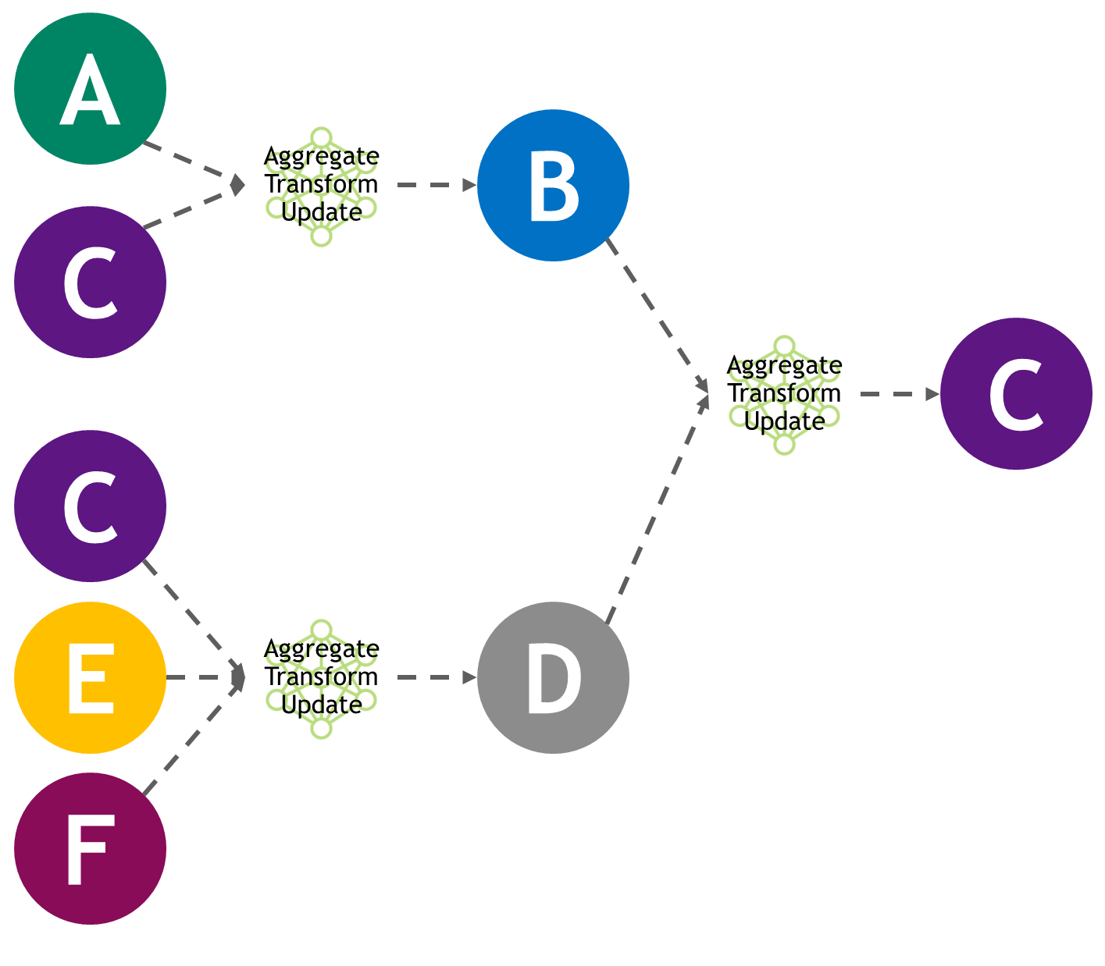
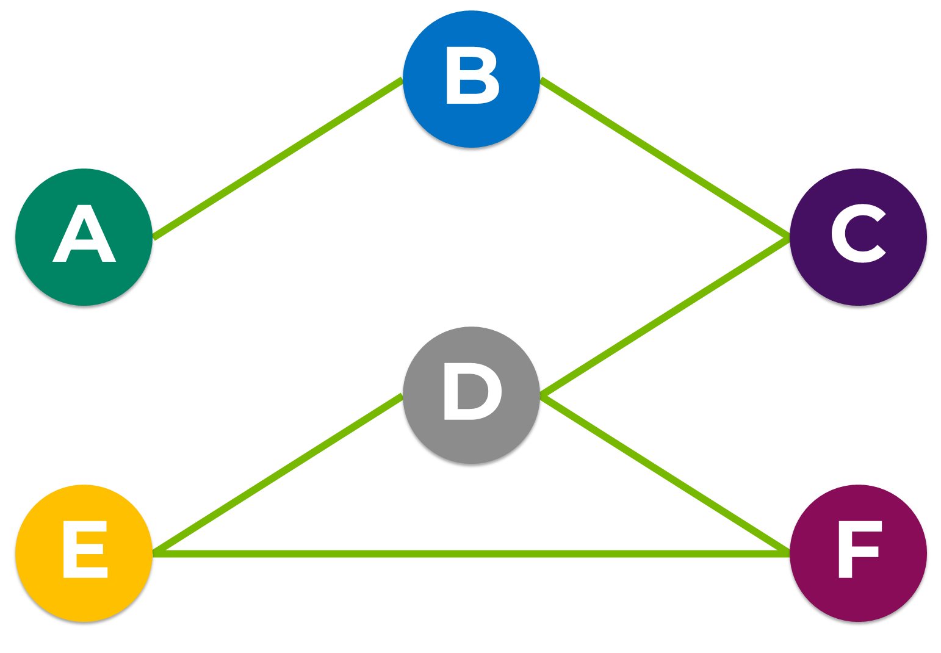
Stacking Layers
Getting Signals From More Distant Neighborhoods in the Graph
By repeating the step N times for all nodes in the graph, the feature representations are updated with information of nodes up to N hops away
Often treated as a hyperparameter for model tuning

Slide 40
GNN Training
Training Is Done in a Similar Way as Other Neural Networks
Learning is done by gradient-descent to minimize the loss function, typically implemented as backpropagation
GNN methods commonly use a semi-supervised learning approach
Depending on the use case, transductive learning may be used
Train the neural network model and label unlabeled points which we have already encountered
Compute embeddings using the entire graph
Can only perform inference on nodes that the model has encountered before
?
¹
⁰
¹
?
⁰

Slide 41
Hands-on Lab

